Slide 1
Optimizing Lennard-Jones Structures

Slide 2
This project was adapted from the following project in: Fundamentals of Differential Equations. Eighth Edition. Nagle, Saff, and Snider. Pg. 151-152

Slide 3
Background

Slide 4

$$\sum_{i<j}^{n}{\frac{1}{{r_{ij}}^{12}}}−\frac{2}{{r_{ij}}^{6}}$$ $$r_{ij}=\sqrt{{\left(x_{i}−x_{i}\right)}^{2}+{\left(y_{i}−y_{i}\right)}^{2}+{\left(z_{i}−z_{i}\right)}^{2}}$$
Lennard Jones Potential
More information: https://en.wikipedia.org/wiki/Lennard-Jones_potential

Slide 5
Jacobian?
Hessian?

Slide 6

$$\sum_{i<j}^{n}{\frac{1}{{R_{ij}}^{6}}}−\frac{2}{{R_{ij}}^{3}}$$ $$R_{ij}={\left(x_{i}−x_{i}\right)}^{2}+{\left(y_{i}−y_{i}\right)}^{2}+{\left(z_{i}−z_{i}\right)}^{2}$$
Redefining for Simplicity…
More information: https://en.wikipedia.org/wiki/Lennard-Jones_potential

Slide 7

$$\left\langle \left[\sum_{i<j, i≠1}^{n}{\frac{1}{{R_{ij}}^{6}}}−\frac{2}{{R_{ij}}^{3}}\right]+\left[\sum_{j=2}^{n}{\left[\frac{−6}{{R_{1j}}^{7}}+\frac{6}{{R_{1j}}^{4}}\right]}∗2\left(x_{1}−x_{j}\right)\right], …\right\rangle$$ $$R_{ij}={\left(x_{i}−x_{i}\right)}^{2}+{\left(y_{i}−y_{i}\right)}^{2}+{\left(z_{i}−z_{i}\right)}^{2}$$
The Jacobian…

Slide 8
The Jacobian appears somewhat cumbersome…
We’ll avoid the Hessian.

Slide 9
Steepest descent with Weakest Line Search:
Fails to:
Find the minimum structure for even very small n
Do so in a reasonable amount of time…

Slide 10
Are we out of luck?

Slide 11
A Jacobian Free Method: Nelder-Mead
Brief Description:
Finds local minima by rolling a simplex
(n-dimensional triangular structure) down to a minimum.
Also called amoeba method.
More information: https://en.wikipedia.org/wiki/Nelder%E2%80%93Mead_method

Slide 12
Bifurcation Diagrams
Show values converged to depending on an input parameter
Often used for illustrating chaos in dynamic systems
We will use them to illustrate chaos arising out of instability in numeric methods
Source/more background: https://en.wikipedia.org/wiki/Bifurcation_diagram

Slide 13

Convergence?
$$\lim_{t→∞}{\frac{e^{10t}}{e^{10t}+9}}=1$$

Slide 14
Euler’s Method

Slide 15
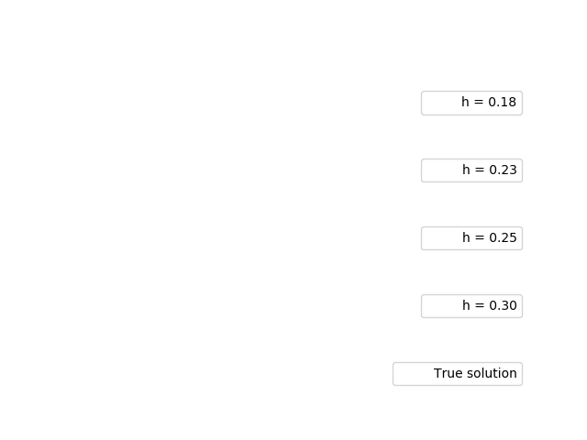

Slide 16


Slide 17
Runge-Kutta 4

Slide 18
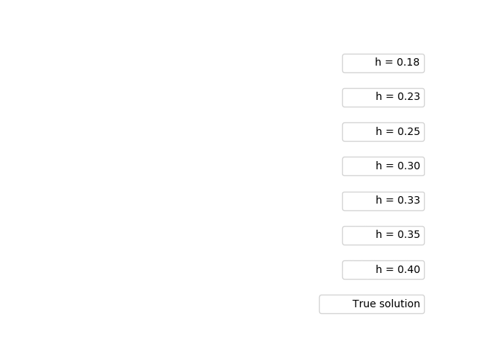

Slide 19


Slide 20
Things that didn’t work…
Backwards Eulers (Newton’s method failed to converge)
Predictor corrector (adams bashforth/moulton 4th order)
Adams bashforth
Rearranging pc4
Predictor corrector 2nd order adams bashforth/ moulton

Slide 21
Backwards Euler’s (Newton’s method failed to converge)

Slide 22
Predictor Corrector (Adams-Bashforth / Adams-Moulton 4th order)

Slide 23

Note that the step size at which pc4 devolves into chaos is around 0.175, which is smaller than 0.18 for which Euler’s converged to the correct value.

Slide 24
Adams-Bashforth (4th order)

Slide 25
Adams-Bashforth (4th order)

Slide 26

Note that the step size at which Adams-Bashforth alone devolves into chaos is even smaller (~0.7 vs ~0.175) than for pc4.

Slide 27
Rearranging math in Predictor Corrector (Adams-Bashforth / Adams-Moulton 4th order)

Slide 28

Note that this is the same diagram as for the original Predictor / Corrector

Slide 29
Exactly the same…

Slide 30
Predictor Corrector (Adams-Bashforth / Adams-Moulton 2nd order)

Slide 31

Somewhat disappointing…

Slide 32
Correcting Adams-Bashforth helped… What about other implicit methods?

Slide 33
Trapezoid

Slide 34


Slide 37
Why are linear multi-step methods worse than single-step here?

Slide 38
“When multistep numerical methods are used, instability problems may arise that cannot be circumvented by simply choosing a sufficiently small step size h. This is because multistep methods yield ‘extraneous solutions,’ which may dominate the calculations….”
Source: Fundamentals of Differential Equations. Eighth Edition. Nagle, Saff, and Snider. Pg. 150

Slide 39
But why?

Slide 40
Some really complicated stuff, that’s why.

